Slide 1
Deterministic PDA
DPDA

Slide 2
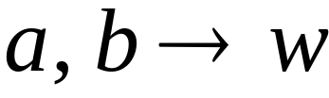


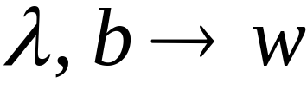


Deterministic PDA: DPDA
Allowed transitions:
(deterministic choices)
Courtesy Costas Busch - RPI

Slide 3
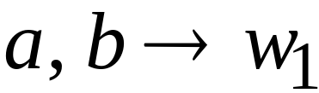
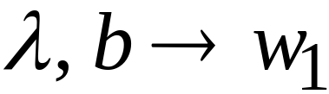
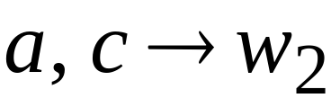
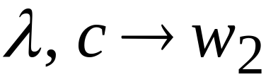

Allowed transitions:
(deterministic choices)
Courtesy Costas Busch - RPI

Slide 4
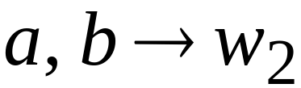
Not allowed:
(non deterministic choices)
Courtesy Costas Busch - RPI

Slide 5
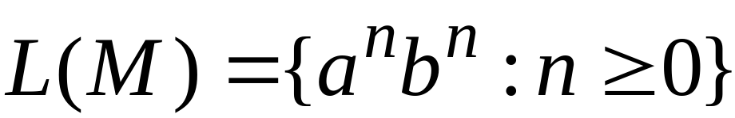




DPDA example
Courtesy Costas Busch - RPI

Slide 6
The language
is deterministic context-free
Courtesy Costas Busch - RPI

Slide 7

Definition:
A language is deterministic context-free
if there exists some DPDA that accepts it
Courtesy Costas Busch - RPI

Slide 8
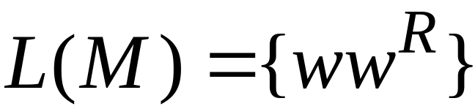
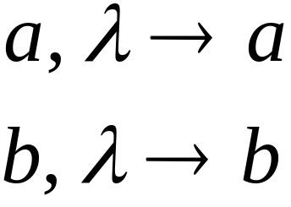
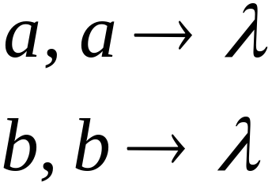

Example of Non-DPDA (NPDA)
Courtesy Costas Busch - RPI

Slide 9
Not allowed in DPDAs
Courtesy Costas Busch - RPI

Slide 10
NPDAs
Have More Power than
DPDAs

Slide 11
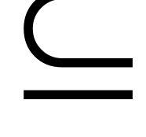
It holds that:
Deterministic
Context-Free
Languages
(DPDA)
Context-Free
Languages
NPDAs
Since every DPDA is also a NPDA
Courtesy Costas Busch - RPI

Slide 12


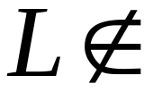
We will actually show:
Deterministic
Context-Free
Languages
(DPDA)
Context-Free
Languages
(NPDA)
We will show that there exists
a context-free language which is not
accepted by any DPDA
Courtesy Costas Busch - RPI

Slide 13
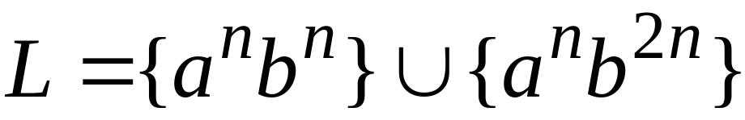

The language is:
We will show:
is context-free
is not deterministic context-free
Courtesy Costas Busch - RPI

Slide 14


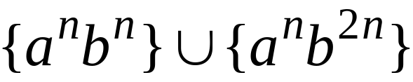
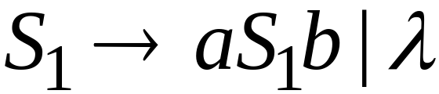
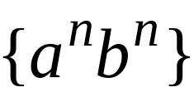
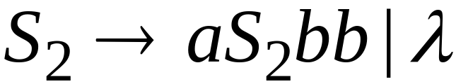
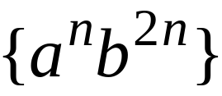
Language is context-free
Context-free grammar for :
Courtesy Costas Busch - RPI

Slide 15
Theorem:
The language
is not deterministic context-free
(there is no DPDA that accepts )
Courtesy Costas Busch - RPI

Slide 16

Proof:
Assume for contradiction that
is deterministic context free
Therefore:
there is a DPDA that accepts
Courtesy Costas Busch - RPI

Slide 17
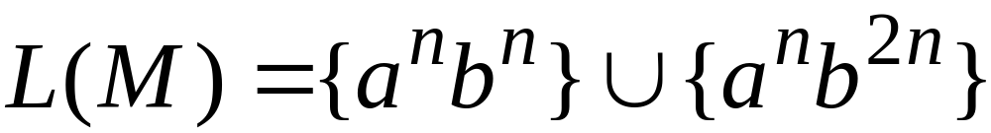
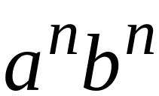
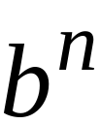
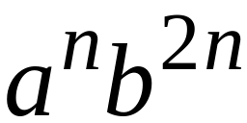
DPDA with
accepts
accepts
Courtesy Costas Busch - RPI

Slide 18
DPDA with
Such a path exists because of the determinism
Courtesy Costas Busch - RPI

Slide 19
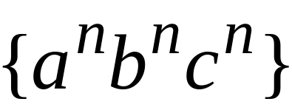


Fact 1:
The language
is not context-free
Context-free languages
Regular languages
(we will prove this at a later class using
pumping lemma for context-free languages)
Courtesy Costas Busch - RPI

Slide 20
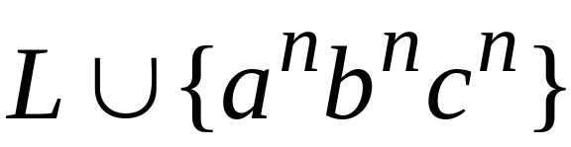
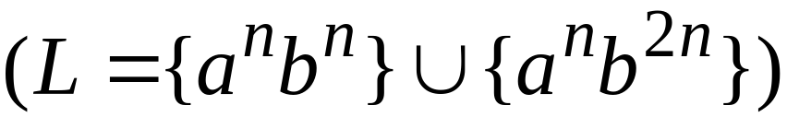
Fact 2:
The language
is not context-free
(we can prove this using pumping lemma
for context-free languages)
Courtesy Costas Busch - RPI

Slide 21
We will construct a NPDA that accepts:
which is a contradiction!
Courtesy Costas Busch - RPI

Slide 22
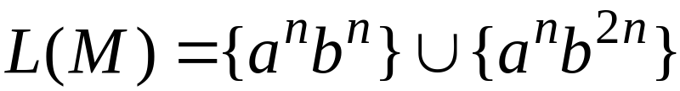



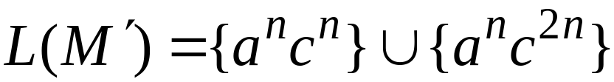
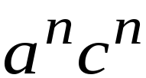

Modify
Replace
with
Courtesy Costas Busch - RPI

Slide 23








The NPDA that accepts
Connect final states of
with final states of
Courtesy Costas Busch - RPI

Slide 24
Since is accepted by a NPDA
it is context-free
Contradiction!
(since is not context-free)
Courtesy Costas Busch - RPI

Slide 25
Therefore:
Not deterministic context free
There is no DPDA that accepts
End of Proof
Courtesy Costas Busch - RPI

